Slide 1
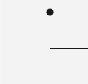

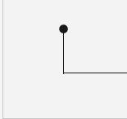
Next-Gen Care Systems: OpenCap Technology in Fall Detection and Alert Mechanisms.
“When something is important enough, you do it even if the odds are not in your favor."
- Elon Musk

Slide 2
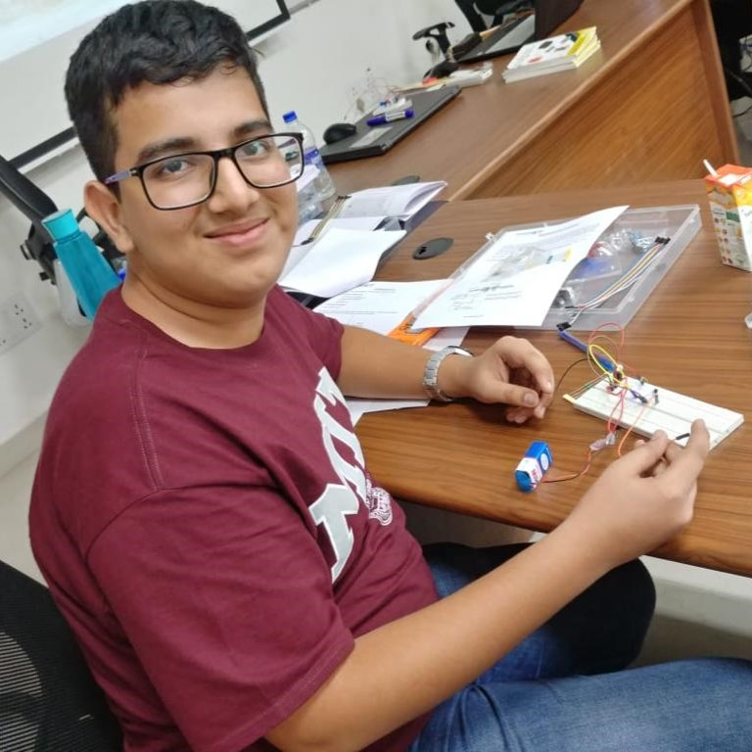




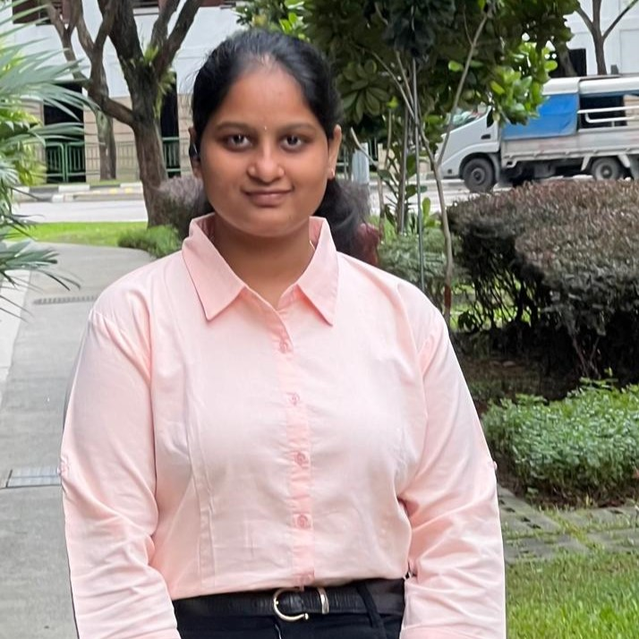

Our team
Aaryan Magnani
Sachita Manna
Md. Anas
Ketki Kelkar
Devyansh Jain
Srihitha Batchu
Ravulapati Shipreethi

Slide 3
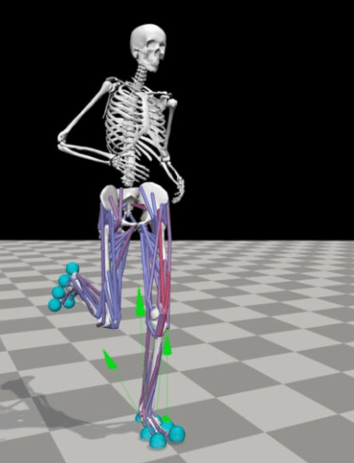
About OpenCap and OpenSim
OpenCap allows you to collect synchronous video data from iPhones, and iPads.
The app allows you to record videos and visualize motion data. You can leverage OpenCap's cloud servers to compute motion and forces Their algorithms automatically compute skeletal motion and musculoskeletal forces.
These utilities allow you to post-process and visualize your data.
OpenSim is an easy-to-use, extensible software for modeling, simulating, controlling, and analyzing the neuromusculoskeletal system.

Slide 4
About our project
History
Vision
Human movement analysis has always been hindered by constraints like cost, accuracy and time. Traditional methods involve expensive equipment and extensive manual analysis by trained experts, limiting the accessibility to precise motion capture technology. In response to these limitations, OpenCap, an open source platform emerges as an innovative solution to computing kinematics and dynamics using smartphone videos.
Leveraging pose estimation algorithms, deep learning, and biomechanical models, OpenCap enables the estimation of three-dimensional kinematics, muscle activations, and musculoskeletal dynamics. Our core objective is to constraints hindering human movement analysis. OpenCap's accurate prediction of dynamic measures showcases its practical utility, enabling clinicians to estimate musculoskeletal dynamics to a high degree of accuracy.

Slide 5
Code and Project Details
Data Processing
Using the Model
Extract useful kinematic and coordinate data of the z-axis of the neck bone from various different OpenCap compiled videos. Assign classes to coordinates depending if they are exhibiting symptoms of a “Fall” or “Not Fall”, respectively 1 or 0.
Take in the current z-axis bone structure and feed it to the trained SVM.
The model classifies whether a given data point of the coordinate belongs to the 0 or 1 category.
Model Training
Final Iteration
Using the previously created dataset to train a linear SVM that takes in processed data of the z-axis of the neck bone and classifies it into the two aforementioned categories.
We use the test size of 20% of the dataset for the SVM model.
Iterative counts to keep check of the actual duration of the fall and keep checking if the object is still in fall.
Use “twilio” API calls to help respond to the emergency of the falls with a text and a call to the saved closed members.

Slide 6
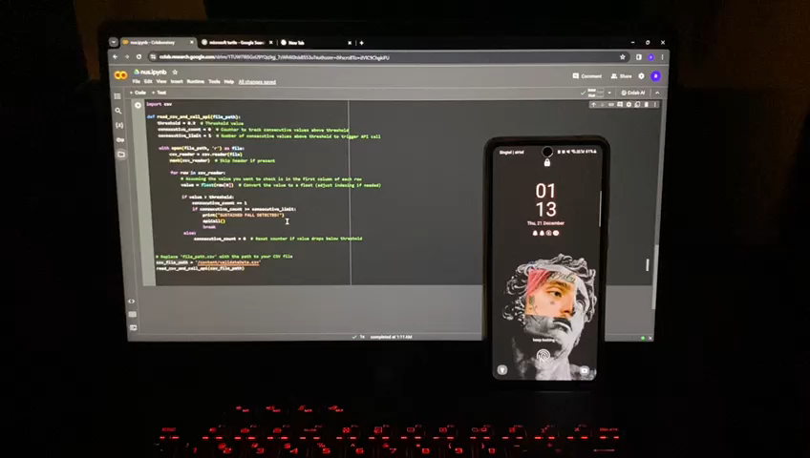
Observation and Result

Slide 7
Future Scope
Refinement of algorithm to reduce chance of false positives
Integration of wearable technology
Expand scope to include other conditions such as Parkinsons disease, Multiple Sclerosis, Muscular Dystrophy etc.
Employ predictive analytics to anticipate potential fall risks based on available data.
Smoother integration of technology to facilitate faster response time.

Slide 8
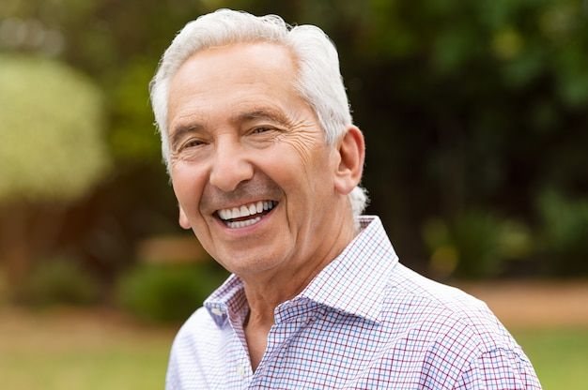
Conclusion
Demographics
Intelligent Monitoring
Adaptive Technology
In summary, this study addresses the intersection of demographic shifts and technological advancements, focusing on the challenges posed by an aging population.
It emphasizes the impact of falls on the elderly and proposes an intelligent monitoring system using OpenCap software to detect falls in real time.
The research underscores the importance of adapting technology to meet the evolving needs of seniors, positioning OpenCap as a flexible platform for intelligent monitoring systems.
Policymakers, healthcare providers, and tech developers can find valuable insights in addressing the urgent issues related to the aging demographic.

Slide 9
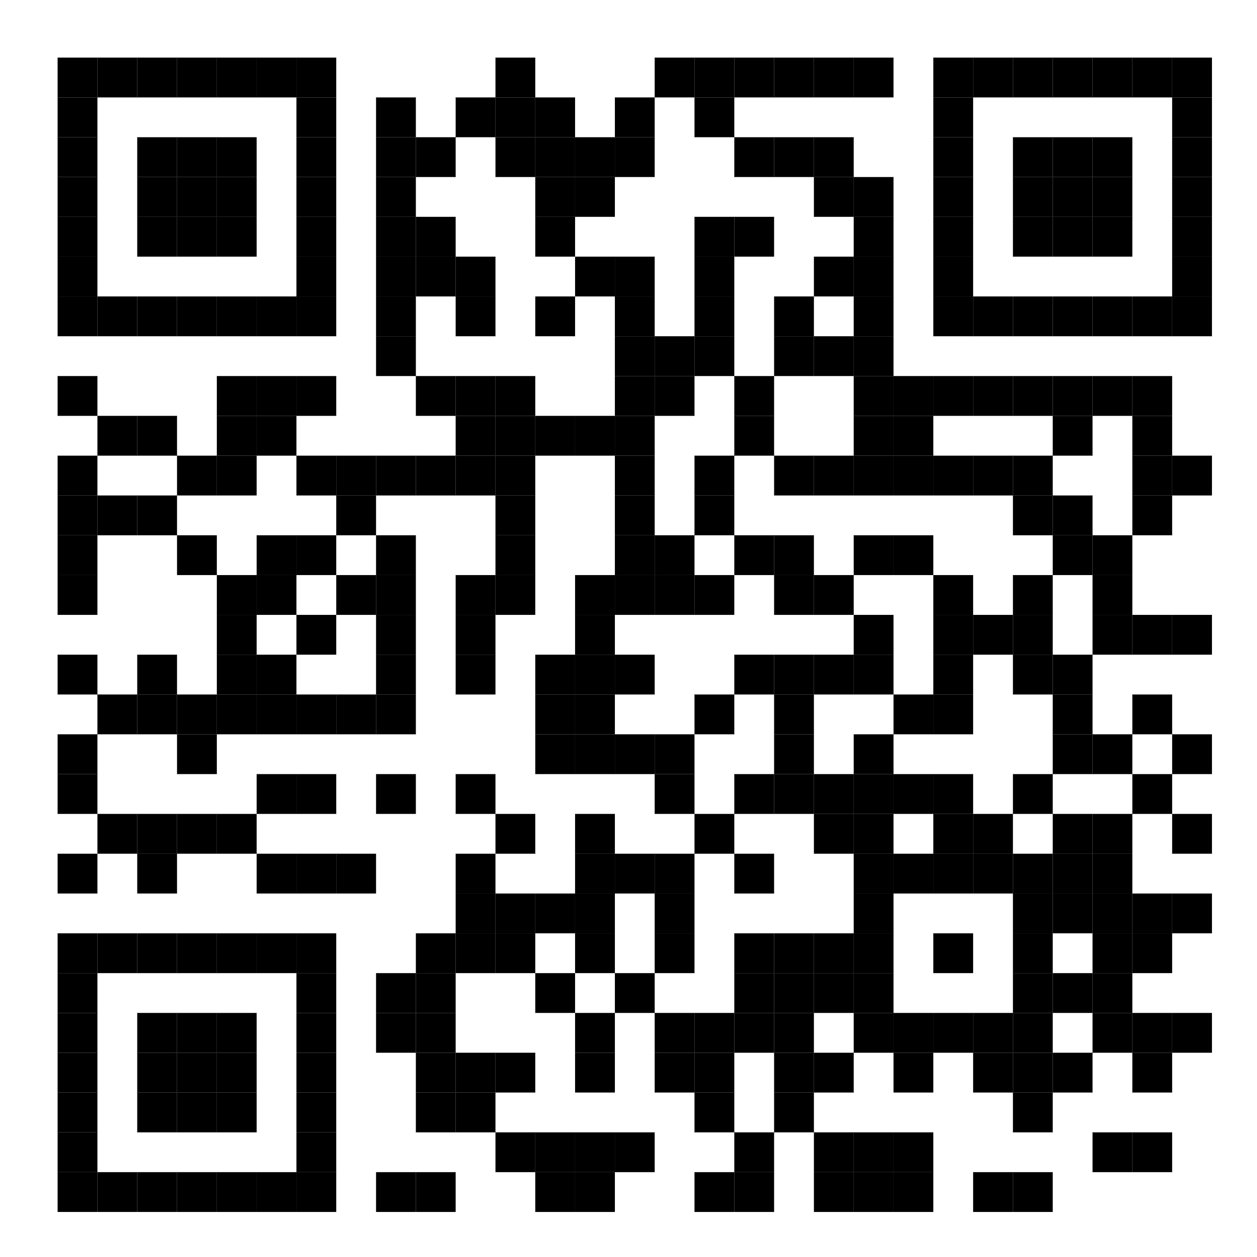
Thanks!
Please scan the QR code for the research paper written by us on the same topic.
Feel Free to ask Questions!!

